Slide 1

307102 Descriptive Statistics for Business
Introduction to Hypothesis Testing
2024-2

Slide 2
Hypothesis Testing
A hypothesis is a claim about a population parameter that can be examined.
Hypothesis Testing is a statistical method that uses sample data to evaluate a hypothesis about a population parameter.
The purpose of hypothesis testing is to determine whether there is enough evidence in a sample of data to support a particular belief about a population.
Examples of claims that can be checked:
The height of students in the university is equal to 170 cm.
The average score for political science students is less than the average score of social science students.
The proportion of female students is larger than the proportion of male students.

Slide 3
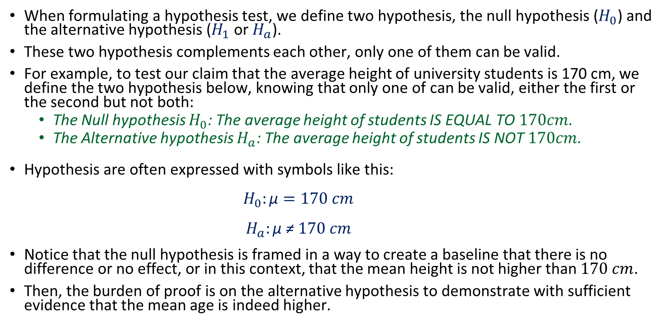
The Null and The Alternative Hypothesis
When formulating a hypothesis test, we define two hypothesis, the null hypothesis ($H_{0}$) and the alternative hypothesis ($H_{1}$ or $H_{a}$).
These two hypothesis complements each other, only one of them can be valid.
For example, to test our claim that the average height of university students is 170 cm, we define the two hypothesis below, knowing that only one of can be valid, either the first or the second but not both:
The Null hypothesis $H_{0}$: The average height of students IS EQUAL TO $170cm$.
The Alternative hypothesis $H_{a}$: The average height of students IS NOT $170cm$.
Hypothesis are often expressed with symbols like this:
$$H_{0}:\text{µ}=170 cm$$
$$H_{a}:\text{µ} \text{≠} 170 cm$$
Notice that the null hypothesis is framed in a way to create a baseline that there is no difference or no effect, or in this context, that the mean height is not higher than $170 cm$.
Then, the burden of proof is on the alternative hypothesis to demonstrate with sufficient evidence that the mean age is indeed higher.

Slide 4
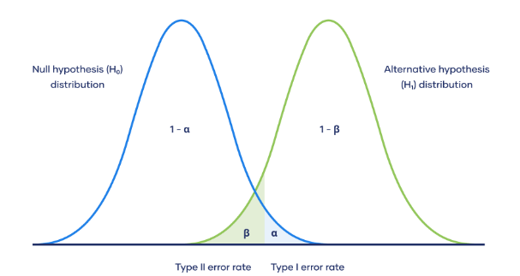
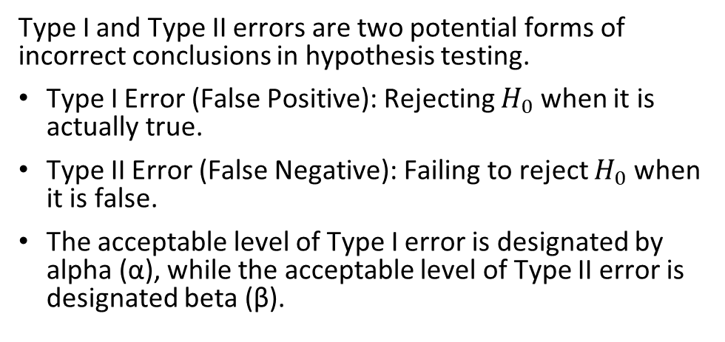
Type I and Type II Errors
Type I and Type II errors are two potential forms of incorrect conclusions in hypothesis testing.
Type I Error (False Positive): Rejecting $H_{0}$ when it is actually true.
Type II Error (False Negative): Failing to reject $H_{0}$ when it is false.
The acceptable level of Type I error is designated by alpha (α), while the acceptable level of Type II error is designated beta (β).
A Type I error occurs when the null hypothesis is incorrectly rejected when it is actually true.
Conversely, a Type II error happens when the null hypothesis is not rejected when it is in fact false, akin to a false negative, where we fail to detect a true effect or difference.
Consider a pharmaceutical company deciding whether a new drug is effective. A Type I error would occur if the company concludes the drug works when it does not, potentially leading to a costly recall and reputation damage when the truth emerges.
On the other hand, a Type II error would be failing to recognize the drug's efficacy, missing out on the opportunity to bring a beneficial product to market, which can result in lost revenue and competitive disadvantage. The company must balance these risks, often prioritizing the avoidance of one type of error over the other based on the potential costs and impacts associated with each.

Slide 5
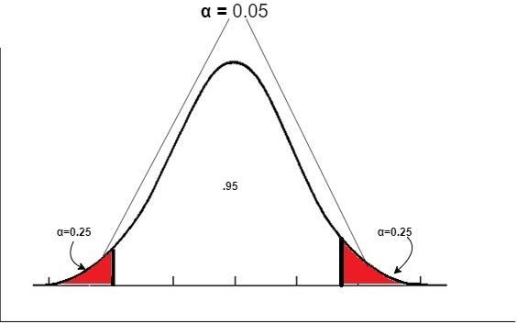
The Significance Level α
Before conducting the test, we need to set the significance level α.
The significance level is a measure of the strength of the evidence that must be present in our sample to reject the null hypothesis and conclude that the effect is statistically significant.
Typical significance levels are: α=0.1 (10%), α=0.05 (5%), α=0.01 (1%)
A lower significance level means that the evidence in the data needs to be stronger to reject the null hypothesis.
There is no "correct" significance level - it only states the amount of uncertainty of the conclusion.
A 5% significance level means that we expect to reject a true null hypothesis 5 out of 100 times (Type I Error).

Slide 6
The Test Statistic
The test statistic is the value we compute based on the sample data that we collect.
The test statistic is used to decide the outcome of the hypothesis test.
We standardize test statistic using:
Z Standard Normal Distribution for large samples or when the variance is known.
The Student's T-Distribution (T) for small samples and the population variance is unknown.

Slide 7
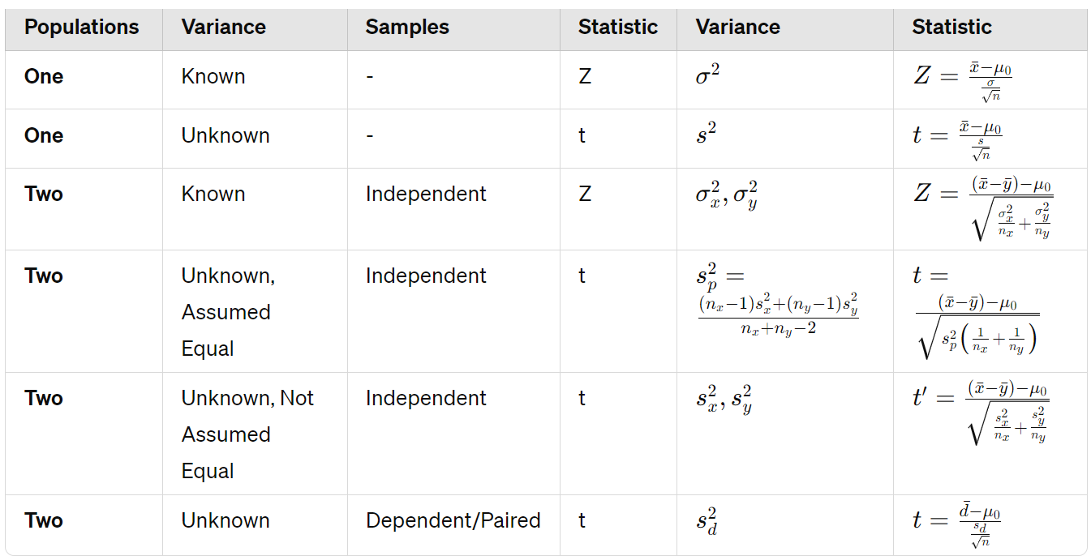
Computing the Test Statistic

Slide 8

The Critical Value and the p-Value Approach to Hypothesis Testing
To decide whether to reject the null hypothesis, a test statistic is calculated.
The decision is made based on the numerical value of that test statistic.
There are two approaches how to arrive at that decision: The critical value approach and the p-value approach.
The critical value approach
By applying the critical value approach, it is determined, whether the observed test statistic is more extreme than a defined critical value.
Therefore, the observed test statistic (calculated based on sample data) is compared to the critical value (a kind of cutoff value).
If the test statistic is more extreme than the critical value, the null hypothesis is rejected.
If the test statistic is not as extreme as the critical value, the null hypothesis is not rejected.
The critical value is computed based on the given significance level α and the type of probability distribution of the idealized model.
The critical value divides the area under the probability distribution curve in rejection region(s) and non-rejection region.

Slide 9
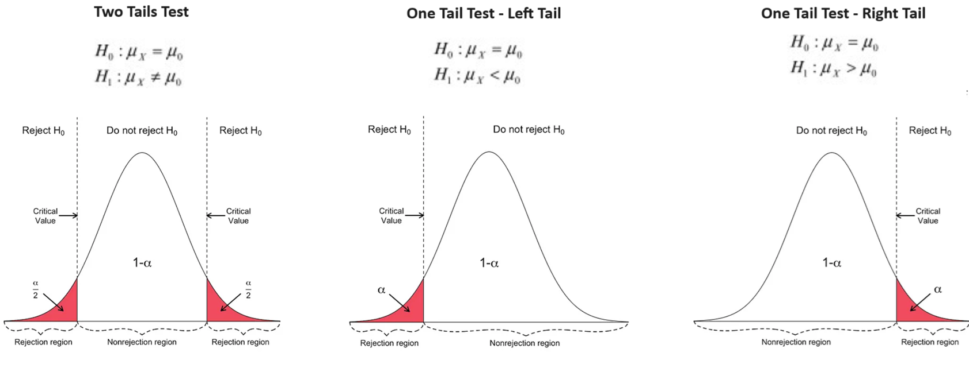
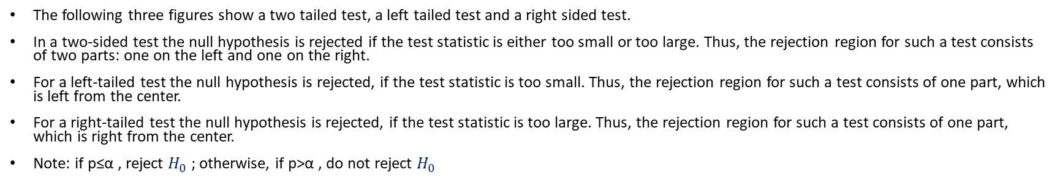
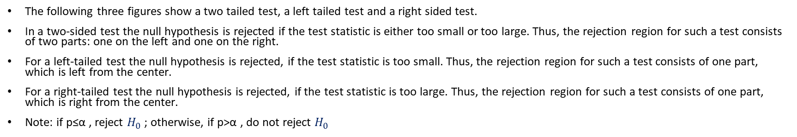
The Critical Value Approach to Hypothesis Testing
The following three figures show a two tailed test, a left tailed test and a right sided test.
In a two-sided test the null hypothesis is rejected if the test statistic is either too small or too large. Thus, the rejection region for such a test consists of two parts: one on the left and one on the right.
For a left-tailed test the null hypothesis is rejected, if the test statistic is too small. Thus, the rejection region for such a test consists of one part, which is left from the center.
For a right-tailed test the null hypothesis is rejected, if the test statistic is too large. Thus, the rejection region for such a test consists of one part, which is right from the center.
Note: if p≤α , reject $H_{0}$ ; otherwise, if p>α , do not reject $H_{0}$

Slide 10
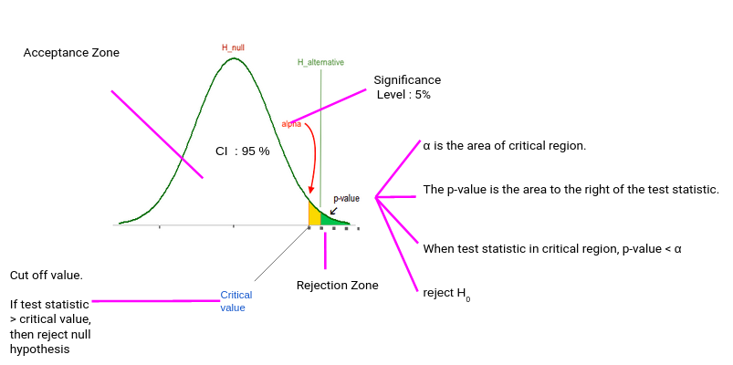
The p-Value Approach to Hypothesis Testing
The p-value represents:
The probability of observing the sample data or more extreme values, given that the null hypothesis is true.
The amount of evidence against the null hypothesis, the smaller (closer to 0) the p-value, the stronger is the evidence against the null hypothesis.
If the p-value (Green Area) is less than or equal to the specified significance level α (Yellow Area) , the null hypothesis is rejected. Otherwise, we fail to reject the null hypothesis.

Slide 11
Statistical Testing Steps
State the hypotheses: Define H0 and H1.
Set the significance level: Choose α (commonly 0.05).
Collect data: Obtain and prepare your data set.
Perform the test: Calculate the test statistic and P-value.
Make a decision: Reject H0 if the P-value is less than α; otherwise, we fail to reject H0.
Note: We cannot we accept the null hypothesis, we can only reject or fail to reject it.
The basis for this testing process comes from logic. For example, if our null hypothesis = All students live in Amman, it will be challenging to check if all students live in Amman. On the other hand, it will be much easier to find just one student who does not live in Amman and therefore reject the null hypothesis → Rejecting is much easier that accepting.

Slide 12
Types of Hypothesis Tests
Z-test: Used for normally distributed data when the variance is known.
One-sample z-test: Tests the mean of a single group against a known mean.
Two-sample z-test: Compares the means of two dependent groups (paired test).
Two-sample z-test: Compares the means of two independent groups.
T-test: Used for normally distributed data when the variance is unknown.
One-sample t-test: Tests the mean of a single group against a known mean.
Two-sample t-test: Compares the means of two dependent groups (paired test).
Two-sample t-test: Compares the means of two independent groups (variance assumed to be equal).
Two-sample t-test: Compares the means of two independent groups (variance assumed to be not equal).
ANOVA (Analysis of Variance): Used to compare the means of three or more samples.
Chi-square test: Tests for relationships between categorical variables.

Slide 13
Hypothesis Testing for One Population Mean

Slide 14
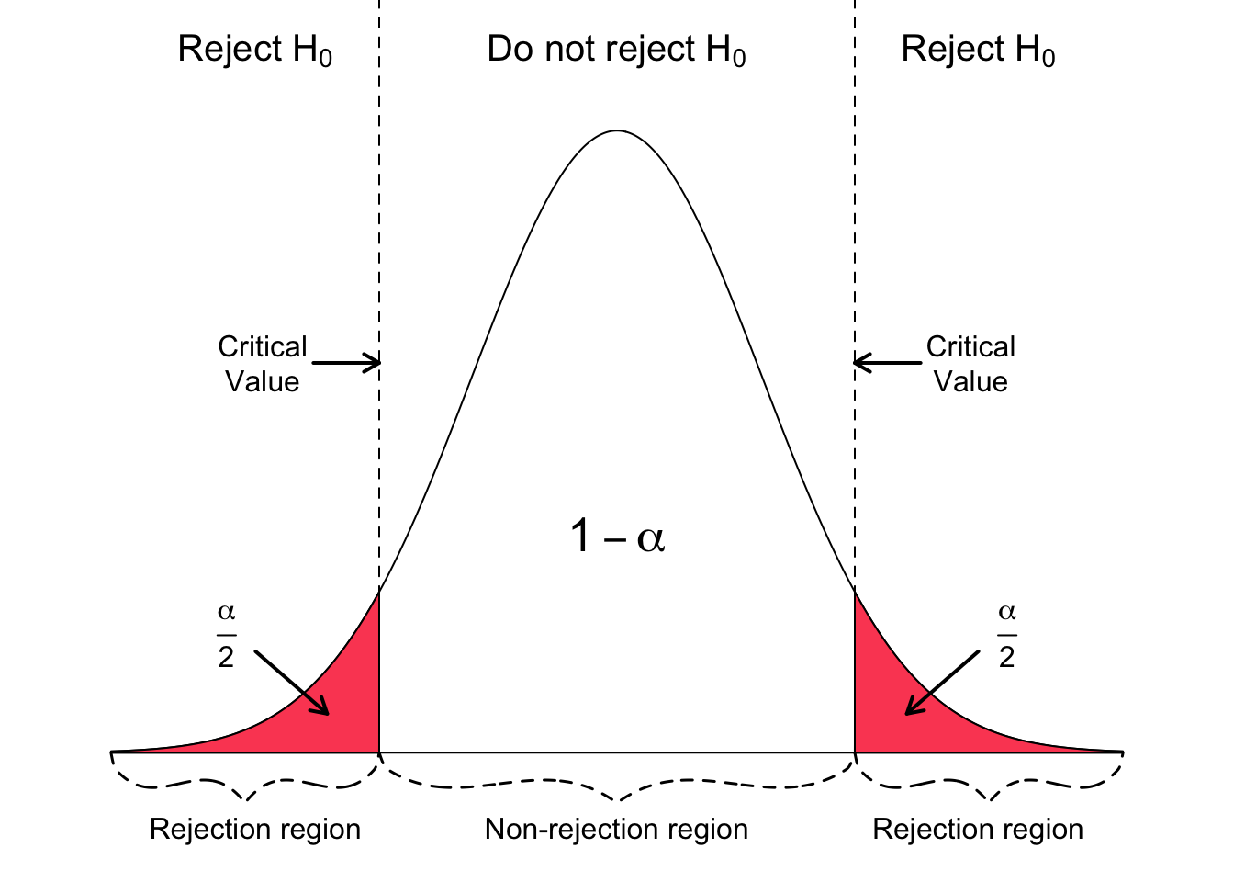

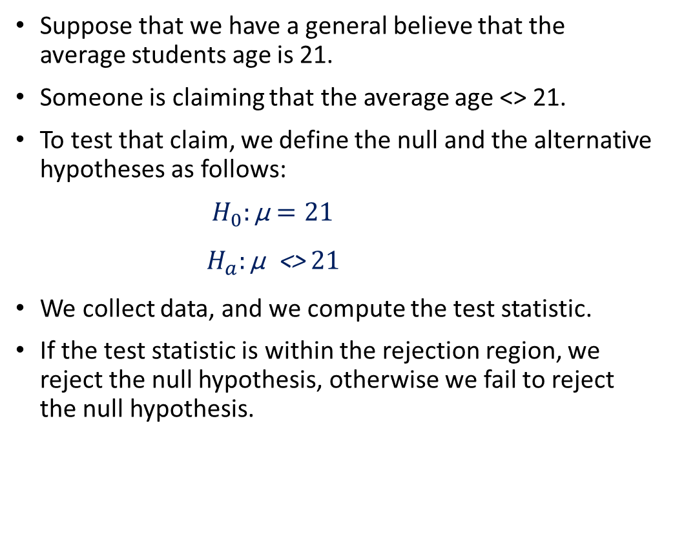
One Sample - Two Tailed Test
Suppose that we have a general believe that the average students age is 21.
Someone is claiming that the average age <> 21.
To test that claim, we define the null and the alternative hypotheses as follows:
$$H_{0}:\text{µ}=21$$
$$H_{a}:\text{µ}\text{ <> }21$$
We collect data, and we compute the test statistic.
If the test statistic is within the rejection region, we reject the null hypothesis, otherwise we fail to reject the null hypothesis.

Slide 15
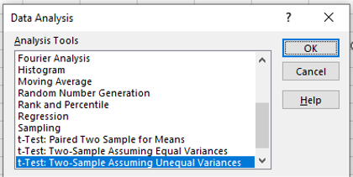
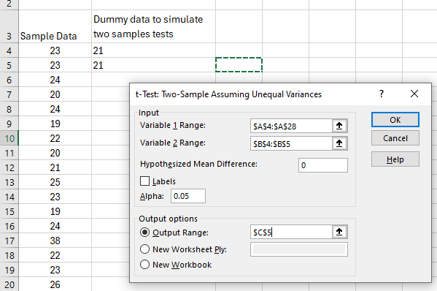
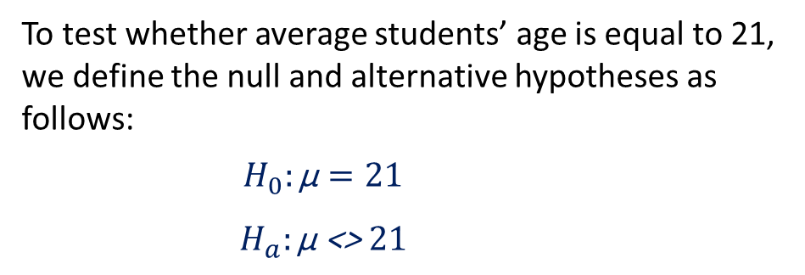
One Sample - Two Tailed Test
Is there enough evidence (at α = .05) to conclude that the population mean age for the university students is different than 21 based on the following sample data?
1
23 | 19 | 23 | 23 | 21
23 | 22 | 19 | 26 | 23
24 | 20 | 24 | 20 | 26
20 | 21 | 38 | 19 | 20
24 | 25 | 22 | 21 | 23
2
To test whether average students’ age is equal to 21, we define the null and alternative hypotheses as follows:
$$H_{0}:\text{µ}=21$$
$$H_{a}:\text{µ}\text{ <> }21$$

Slide 16
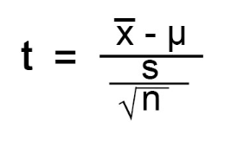
One Sample - Two Tailed Test
According to the test results, we reject the null hypothesis that the mean is equal to 21.
Using our sample data, we found that the average students age is more than 21 with significant evidence.
We reached this conclusion because the t statistic is larger than the critical value (falls inside the rejection region).
We also reached that conclusion because the p-value (0.0294) which is less than 0.05.
 | Age | Dummy
Mean | 22.76 | 21
Variance | 14.44 | 0
Observations | 25 | 2
Hypothesized Mean Difference | 0
df | 24
t Stat | 2.315789474
P(T<=t) one-tail | 0.014715837
t Critical one-tail | 1.71088208
P(T<=t) two-tail | 0.029431673
t Critical two-tail | 2.063898562

Slide 17
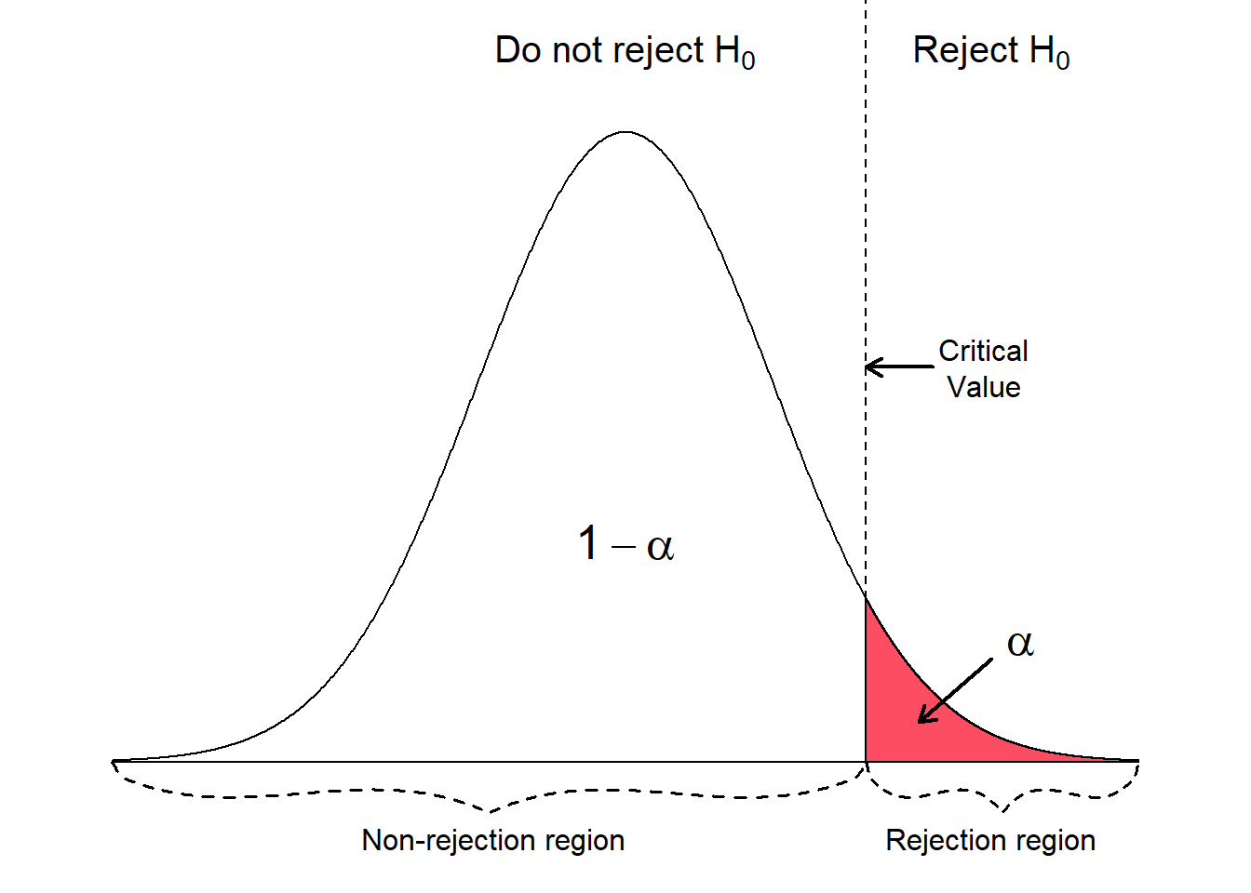

One Sample - One Tailed Test (Upper Tail Test)
Suppose that we have a general believe that the average students age is 21.
Someone is claiming that the average age > 21.
To test that claim, we define the null and the alternative hypotheses as follows:
$$H_{0}:\text{µ}≤21$$
$$H_{a}:\text{µ}\text{ > }21$$
We collect data, and we compute the test statistic.
If the test statistic is within the rejection region, we reject the null hypothesis, otherwise we fail to reject the null hypothesis.

Slide 18
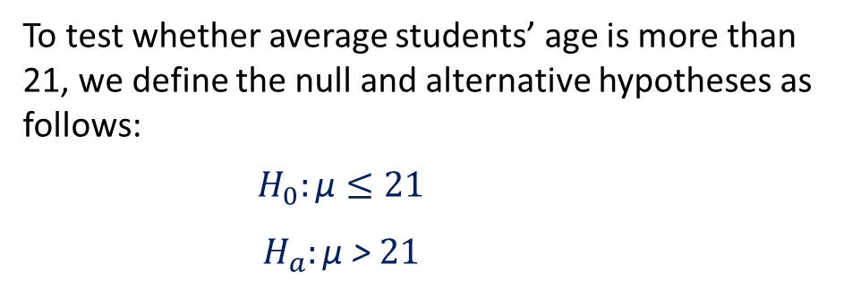
One Sample - One Tailed Test (Upper Tail Test)
Is there enough evidence (at α = .05) to conclude that the population mean age for the university students is higher than 21 based on the following sample data?
1
23 | 19 | 23 | 23 | 21
23 | 22 | 19 | 26 | 23
24 | 20 | 24 | 20 | 26
20 | 21 | 38 | 19 | 20
24 | 25 | 22 | 21 | 23
2
To test whether average students’ age is more than 21, we define the null and alternative hypotheses as follows:
$$H_{0}:\text{µ}≤21$$
$$H_{a}:\text{µ}\text{ > }21$$

Slide 19
One Sample - One Tailed Test (Upper Tail Test)
According to the test results, we reject the null hypothesis that the mean is less than or equal to 21.
Using our sample data, we found that the average students age is more than 21 with significant evidence.
We reached this conclusion because the t statistic is larger than the critical value (falls inside the rejection region).
We also reached that conclusion because the p-value (0.014) which is less than 0.05.
 | Age | Dummy
Mean | 22.76 | 21
Variance | 14.44 | 0
Observations | 25 | 2
Hypothesized Mean Difference | 0
df | 24
t Stat | 2.315789474
P(T<=t) one-tail | 0.014715837
t Critical one-tail | 1.71088208
P(T<=t) two-tail | 0.029431673
t Critical two-tail | 2.063898562

Slide 20
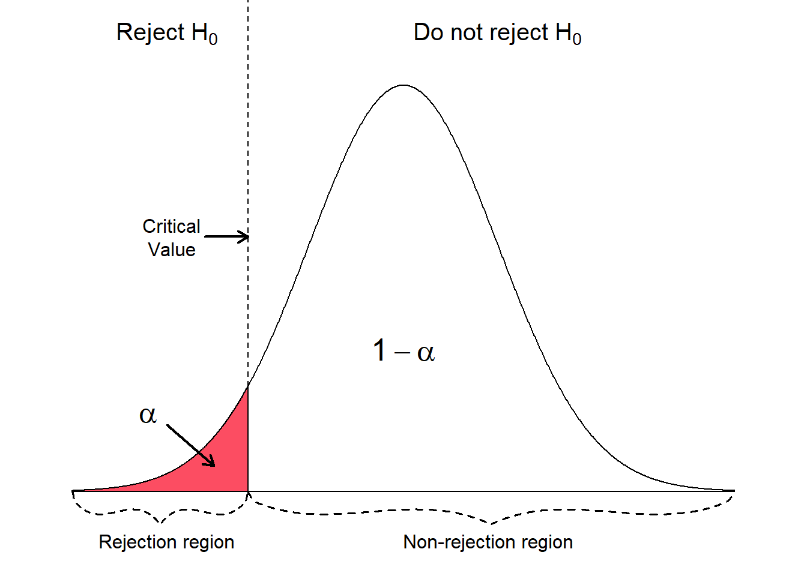
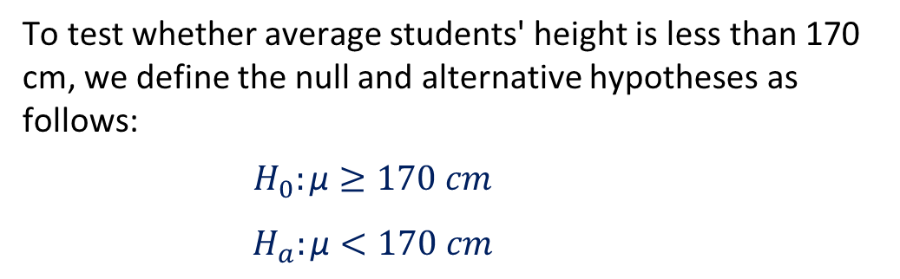
One Sample - One Tailed Test (Lower Tail Test)
Is there enough evidence (at α = .05) to conclude that the population mean height for the university students is less than 170 based on the following sample data?
175.65 | 164.61 | 165.96 | 168.59
171.82 | 167.32 | 175.88 | 167.56
166.08 | 167.17 | 164.32 | 163.92
167.49 | 175.20 | 172.61 | 176.43
169.61 | 163.77 | 171.58 | 174.42
To test whether average students' height is less than 170 cm, we define the null and alternative hypotheses as follows:
$$H_{0}:\text{µ}≥170 cm$$
$$H_{a}:\text{µ}<170 cm$$

Slide 21
Hypothesis Testing for Two Populations Means

Slide 22
Types of Hypothesis Tests
Z-test: Used for normally distributed data when the variance is known.
One-sample z-test: Tests the mean of a single group against a known mean.
Two-sample z-test: Compares the means of two dependent groups (paired test).
Two-sample z-test: Compares the means of two independent groups.
T-test: Used for normally distributed data when the variance is unknown.
One-sample t-test: Tests the mean of a single group against a known mean.
Two-sample t-test: Compares the means of two dependent groups (Paired t test).
Two-sample t-test: Compares the means of two independent groups (variance assumed to be equal).
Two-sample t-test: Compares the means of two independent groups (variance assumed to be not equal).
ANOVA (Analysis of Variance): Used to compare the means of three or more samples.
Chi-square test: Tests for relationships between categorical variables.

Slide 23
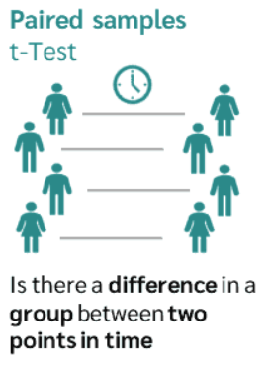
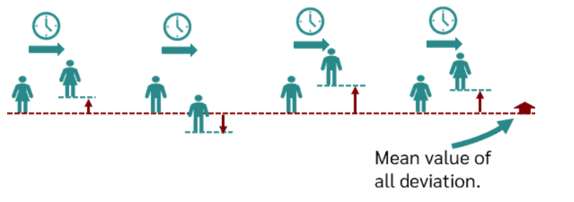
Compares the means of two dependent groups (Paired T Test)
The dependent samples T-test (or paired samples t-test) is a statistical test that determines whether there is a difference between two dependent groups or samples.
We need the paired t-test whenever we survey the same group or sample at two points in time.
This can be the case, for example, in longitudinal studies with several measurement points (time series analyses) or in intervention studies with experimental designs (before-after measurement).
An example of dependent sampling is when the weight of a group of people is measured at two points in time (before and after going into a diet).
The weight of a person can be measured individually before and after going into the diet, and the difference in the measured values can be calculated in each case.

Slide 24
Compares the means of two dependent groups (Paired T Test)
We are interested in the question whether an online statistics learning tutorial helps students improve their grades.
There are three variables of interest in the student's data set (score1, score2 and online.tutorial).
The variables score1 and score2 show the grades (0-100) for two exams on mathematics after attending online training. The higher the value the better the student performed.
The variable online.tutorial is a binary variable, which is 1 if the student completed the online statistics learning tutorial, or 0 otherwise.
The first exam takes place before the students attended the online statistics learning tutorial.
The participation in the online statistics learning tutorial is not mandatory, however the two exams are obligatory for all students.
We want to examine if the group of students, which attended the online statistics learning tutorial, performs better on the second exam compared to the first exam.
Random sample of students who took the online training
` | Score 1 | Score 2
1 | 67 | 71
2 | 62 | 64
3 | 60 | 57
4 | 53 | 52
5 | 75 | 77
6 | 64 | 79
7 | 43 | 48
8 | 74 | 70
9 | 59 | 53
10 | 54 | 58
11 | 66 | 66
12 | 81 | 90
13 | 55 | 57
14 | 64 | 68
15 | 72 | 71
16 | 76 | 78
17 | 75 | 73
18 | 90 | 92
19 | 83 | 90
20 | 64 | 73
21 | 49 | 51
22 | 41 | 51
23 | 75 | 87
24 | 66 | 66
25 | 75 | 74
26 | 49 | 57
27 | 91 | 89
28 | 68 | 69
29 | 72 | 72
30 | 87 | 93
$$H_{0}:{\text{µ}}_{score2}≤{\text{µ}}_{score1}$$ | Null Hypothesis states that there is no effect for the intervention
$$H_{1}:{\text{µ}}_{score2\text{ > }}{\text{µ}}_{score1}$$ | Alternative Hypothesis claims that the intervention caused an effect

Slide 25
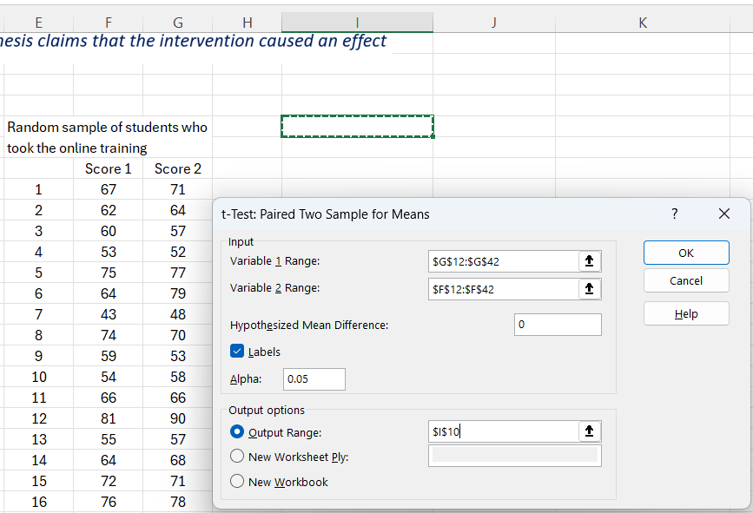
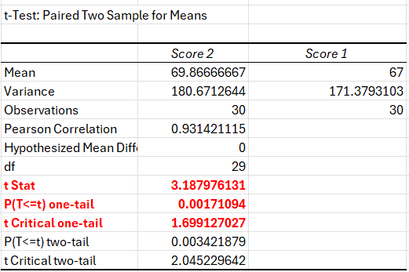
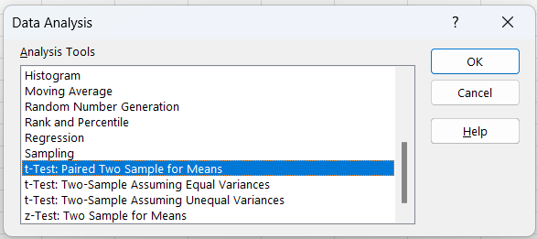
Compares the means of two dependent groups (Paired T Test)
2
3
1
Based on the sample data and the test statistic, we found that there is a statistically significant difference between the before and after score, the after score (score2) is higher than score1.
This finding is supported by the test statistic and the p-value, therefore we REJECT the null hypothesis, and we conclude that the online tutorial helped students in enhancing their exam performance.

Slide 26
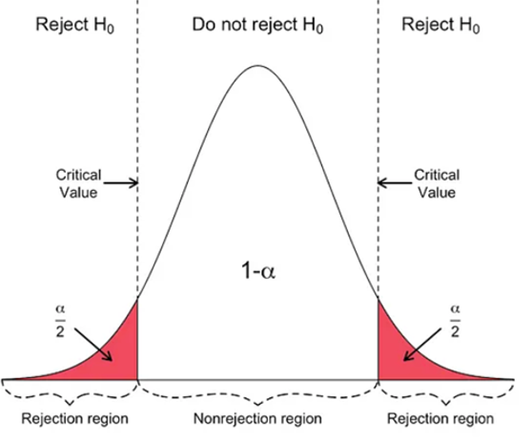

Compares the means of two independent groups (variance assumed to be equal)
In this section we perform a hypothesis test for the means of two populations.
We examine the mean annual salary (in Euro) of graduates.
The first population consist of male students and the second population of female students.
The standard deviations of the two populations are unknown but assumed to be equal.
The question is, whether there is a difference (at α 5%) in the mean annual salary of graduates related to gender (two tailed test)
 | Male Random Sample | Female Random Sample
1 | $39,647.68 | $29,543.60
2 | $55,726.10 | $30,972.76
3 | $34,717.77 | $33,216.12
4 | $29,999.35 | $24,143.27
5 | $50,763.66 | $40,466.69
6 | $52,433.73 | $29,543.60
7 | $44,385.84 | $47,760.48
8 | $36,599.27 | $45,054.95
9 | $47,842.44 | $42,742.79
10 | $30,854.42 | $42,202.39
11 | $58,614.72 | $40,606.41
12 | $62,887.03 | $29,783.76
13 | $48,288.53 | $46,945.17
14 | $43,191.15 | $29,555.94
15 | $43,756.58 | $45,042.30
16 | $48,453.00 | $29,555.94
17 | $23,090.67 | $45,625.09
18 | $55,660.20 | $28,017.87
19 | $57,527.17 | $35,840.90
20 | $65,776.23 | $33,648.38
21 | $50,011.69 | $46,858.67
22 | $46,213.64 | $42,463.48
23 | $42,211.41 | $33,200.27
24 | $61,384.55 | $28,338.17
25 | $49,780.18 | $26,265.35
26 | $50,474.57 | $34,373.99
27 | $43,281.92 | $37,312.85
28 | $55,484.64 | $37,709.73
29 | $24,409.73 | $35,106.01
30 | $40,489.49 | $37,807.11
$$H_{0}:{\text{µ}}_{male}={\text{µ}}_{female}$$ | Null Hypothesis states that there is no difference
$$H_{1}:{\text{µ}}_{male \text{≠} }{\text{µ}}_{female}$$ | Alternative Hypothesis claims that there is a difference

Slide 27
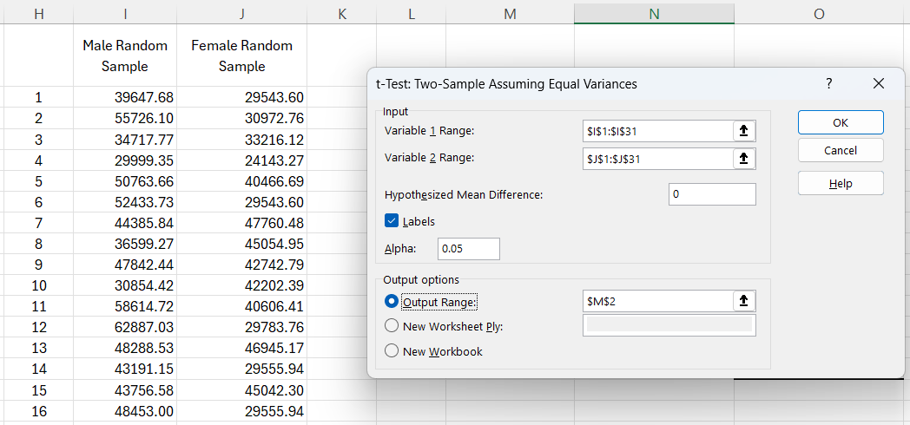
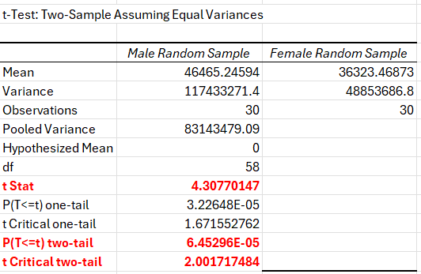
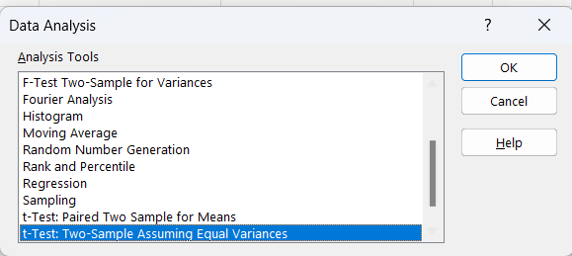
Compares the means of two independent groups (variance assumed to be equal)
3
2
1
Based on the sample data and the test statistic, we found that there is a statistically significant difference between male salaries and female salaries.
This finding is supported by the test statistic and the p-value, therefore we REJECT the null hypothesis, and we conclude that the salaries of male graduates and female graduates are not equal.

Slide 28
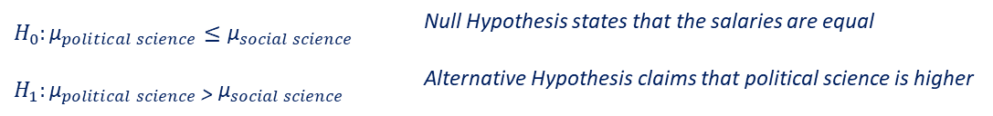
Compares the means of two independent groups (variance assumed to be not equal)
In this section we perform a hypothesis test for the means of two populations to showcase the non-pooled t-test.
We are testing a claim that states that the annual salaries for political science female students is higher than the annual salaries of the social science female students.
The standard deviations of the two populations are unknown and assumed to be unequal.
We want to test at α 1%, whether the mean political science salary is higher than the mean salary of the social science (one tail test, upper tail).
 | Political Science Random Sample | Social Science Random Sample
1 | $30,796.16 | $33,641.73
2 | $32,038.41 | $29,635.67
3 | $32,038.41 | $38,738.01
4 | $32,996.39 | $21,453.99
5 | $33,648.38 | $31,484.80
6 | $41,430.16 | $34,287.96
7 | $40,032.78 | $35,583.43
8 | $39,710.80 | $28,672.85
9 | $36,911.26 | $30,062.71
10 | $45,900.13 | $34,420.48
11 | $35,270.19 | $33,641.73
12 | $43,318.41 | $26,291.32
13 | $41,282.13 | $31,151.42
14 | $41,430.16 | $38,738.01
15 | $21,485.62 | $33,565.74
16 | $29,195.50 | $31,484.80
17 | $45,141.81 | $32,194.59
18 | $34,492.08 | $35,746.22
19 | $27,893.26 | $28,281.25
20 | $38,591.54 | $31,405.48
21 | $33,726.58 | $32,194.59
22 | $29,832.22 | $35,987.41
23 | $32,154.94 | $35,583.43
24 | $34,686.49 | $34,227.49
25 | $25,607.82 | $25,758.88
26 | $33,726.58 | $34,373.99
27 | $37,782.86 | $25,658.83
28 | $35,507.83 | $34,201.58
29 | $33,955.21 | $31,151.42
30 | $25,883.03 | $33,641.73
$$H_{0}:{\text{µ}}_{political science}≤{\text{µ}}_{social science}$$ | Null Hypothesis states that the salaries are equal
$$H_{1}:{\text{µ}}_{political science\text{ > }}{\text{µ}}_{social science}$$ | Alternative Hypothesis claims that political science is higher

Slide 29
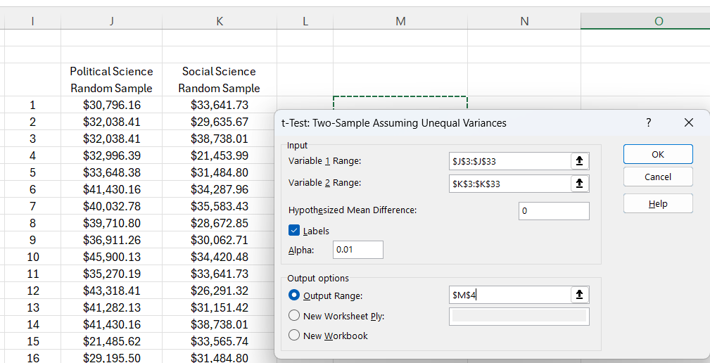
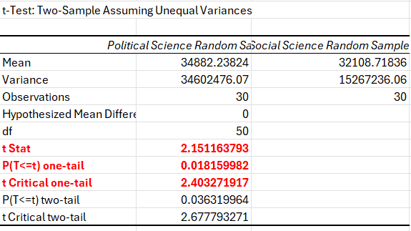
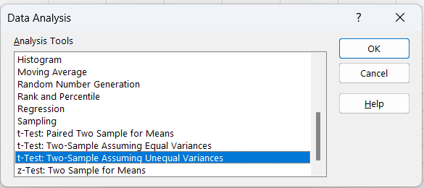
Compares the means of two independent groups (variance assumed to be not equal)
2
3
1
Based on the sample data and the test statistic, we found that there is no statistically significant difference (at α 1%) between the salaries of political science and social science.
This finding is supported by the test statistic and the p-value 0.018 > 0.01, therefore we FAIL TO REJECT the null hypothesis which states that the salaries of political science and social science are equal for female graduates.

Slide 30
Hypothesis Testing for More than Two Populations Means
One Way ANOVA

Slide 31
Introduction to One-Way ANOVA
Definition: One-Way ANOVA is a statistical test that compares the means of three or more independent groups to determine if at least one group mean is statistically different from the others.
Purpose: To test for significant differences between the means of multiple groups when you have one categorical independent variable and one continuous dependent variable.
Appropriate Use Cases:
Comparing customer satisfaction levels across different store locations.
Examining student performance across different teaching methods.
Key Advantage:
Allows simultaneous comparison of more than two groups, providing a broader analysis than t-tests.

Slide 32
ANOVA
Hypothesis in One-Way ANOVA:
Null Hypothesis (H0): All group means are equal.
Alternative Hypothesis (H1): At least one group mean is different from the others.
How to Calculate?
Calculate Group Means and Overall Mean
Compute Sum of Squares:
Total Sum of Squares (SST): Variability of all data points around the overall mean.
Within-Group Sum of Squares (SSW): Variability within each group.
Between-Group Sum of Squares (SSB): Variability due to the interaction between the groups.
Calculate Mean Squares:
Mean Square Between (MSB): SSB divided by the degrees of freedom between groups (k-1).
Mean Square Within (MSW): SSW divided by the degrees of freedom within groups (N-k).
F-Statistic:
F = MSB / MSW

Slide 33
ANOVA Example
Scenario: A school tests three different teaching methods to determine which one results in the best performance on a standardized test.
The students are randomly assigned to one of three groups, each receiving instruction through a different method. Their scores on a standardized test are recorded.
Variables:
Group: The teaching method group (A, B, C)
Score: The score each student received on the standardized test.
Student ID | Group | Score
1 | A | 82
2 | A | 88
3 | A | 84
4 | A | 90
5 | A | 85
6 | B | 78
7 | B | 75
8 | B | 80
9 | B | 82
10 | B | 77
11 | C | 90
12 | C | 92
13 | C | 95
14 | C | 91
15 | C | 94

Slide 34
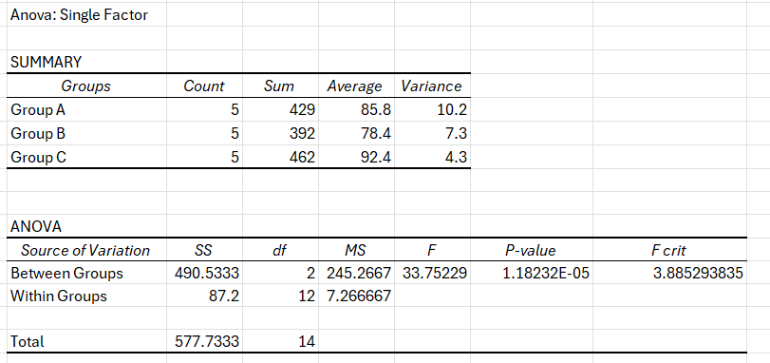
Interpreting Results
F-Statistic and P-Value:
An F-Statistic higher than the critical value or a P-value less than the alpha level (e.g., 0.05) indicates significant differences between group means.
Post Hoc Tests:
If the ANOVA is significant, perform post hoc tests (e.g., Tukey’s HSD) to determine which specific groups differ from each other.
Both the F-Statistic and the P-value indicate significant difference between groups means, therefore we reject the null hypothesis.

Slide 35
2-Way ANOVA
Case Study: Effect of Teaching Method and Gender on Student Performance
Objective:
A school administrator wants to investigate whether student performance is affected by:
Teaching method (Traditional vs. Online)
Student gender (Male vs. Female)
This leads to a 2x2 factorial design:
Factor A: Teaching Method (Traditional, Online)
Factor B: Gender (Male, Female)
Response Variable: Final Exam Score (numerical)

Slide 36
2-Way ANOVA
Gender | Teaching Method | Exam Score
Male | Traditional | 75
Male | Traditional | 78
Female | Traditional | 85
Female | Traditional | 82
Male | Online | 70
Male | Online | 68
Female | Online | 80
Female | Online | 83
 | Traditional |  | Online
 | Male | Female | Male | Female
Score1 | 75 | 85 | 70 | 80
Score2 | 78 | 82 | 68 | 83

Slide 37
Hypothesis Testing for Categorical Data
Chi-Square Tests

Slide 38
Introduction to Chi-Square Tests
Definition: Chi-Square tests are statistical methods used to determine if there is a significant association between categorical variables.
Types of Chi-Square Tests:
Test of Independence: Determines if two or more categories are independent.
Goodness of Fit Test: Determines if a sample matches an expected distribution.

Slide 39
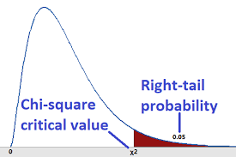
Focus on Chi-Square Test of Independence
Purpose: To assess whether observed frequencies in a contingency table differ significantly from expected frequencies derived from hypothesis.
Applicable Scenarios: Useful in marketing research, opinion polling, healthcare, and demographic studies.

Slide 40
Assumptions of the Chi-Square Test of Independence
Sample Adequacy: The sample size should be large enough, typically each category should have an expected frequency of 5 or more.
Independence: Observations must be independent of each other.
Random Sampling: Data should be collected randomly.
Data Level: The test requires nominal or ordinal data.

Slide 41
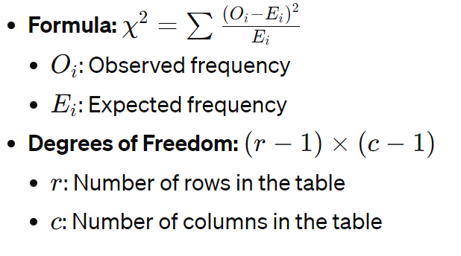
The Chi-Square Statistic

Slide 42
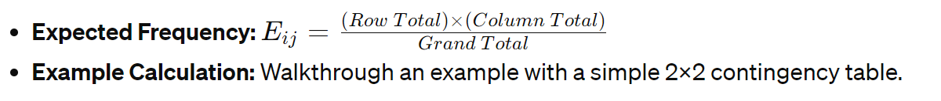
Calculating Expected Frequencies

Slide 43
Conducting the Test
Step-by-Step Process:
Set up the contingency table.
Calculate expected frequencies for each cell.
Compute Chi-Square statistic using the formula.
Compare the calculated Chi-Square to the critical value from Chi-Square distribution table based on degrees of freedom and significance level.

Slide 44
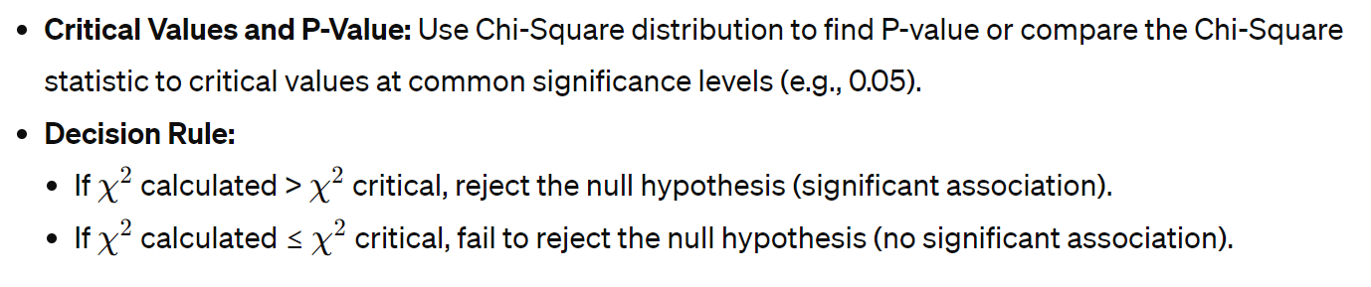
Interpreting Results

Slide 45
Example: Product Preference Across Age Groups
A company wants to determine if there is a significant association between the age group of its customers and their preference for one of two new beverage products. The marketing team has conducted a survey and collected data from different age groups.
Data Collected
Here's the observed frequency table based on the survey:
 | Product A | Product B | Total
Under 30 | 30 | 40 | 70
30 to 50 | 50 | 30 | 80
Over 50 | 20 | 30 | 50
Total | 100 | 100 | 200
Task
Perform a Chi-Square Test of Independence to determine if there's a significant relationship between age group and product preference.

Slide 46
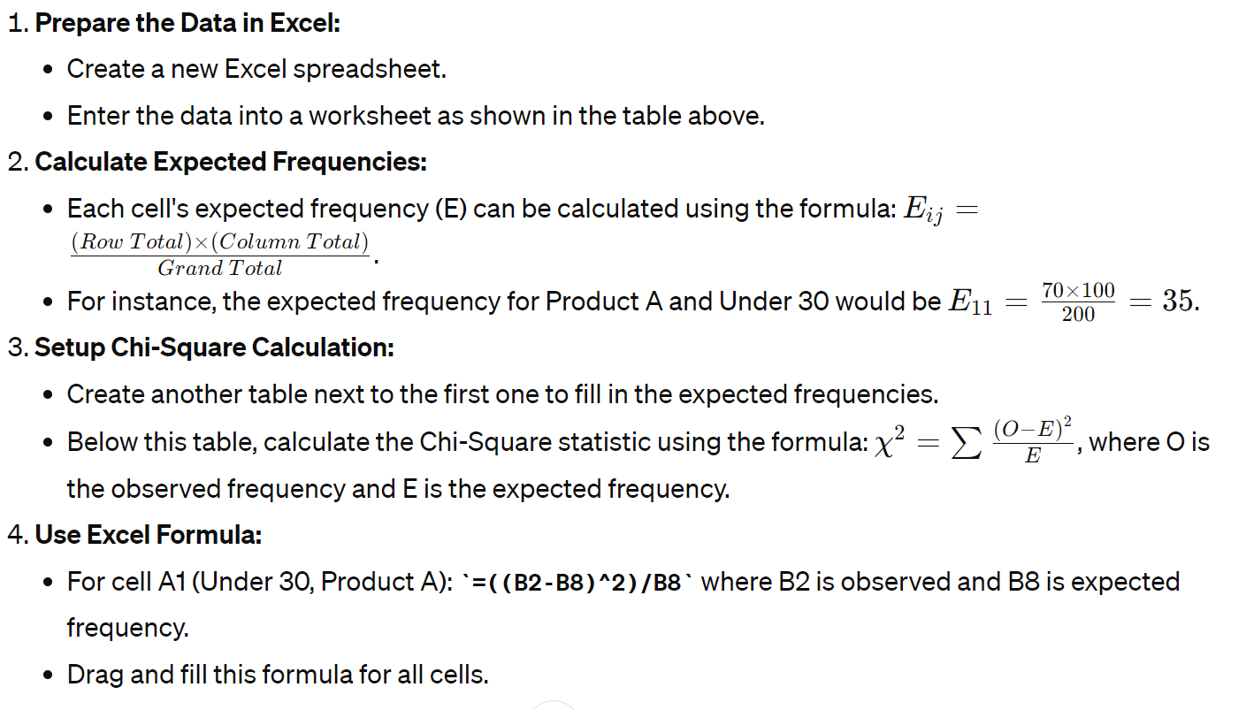
Steps to Solve in Excel

Slide 47
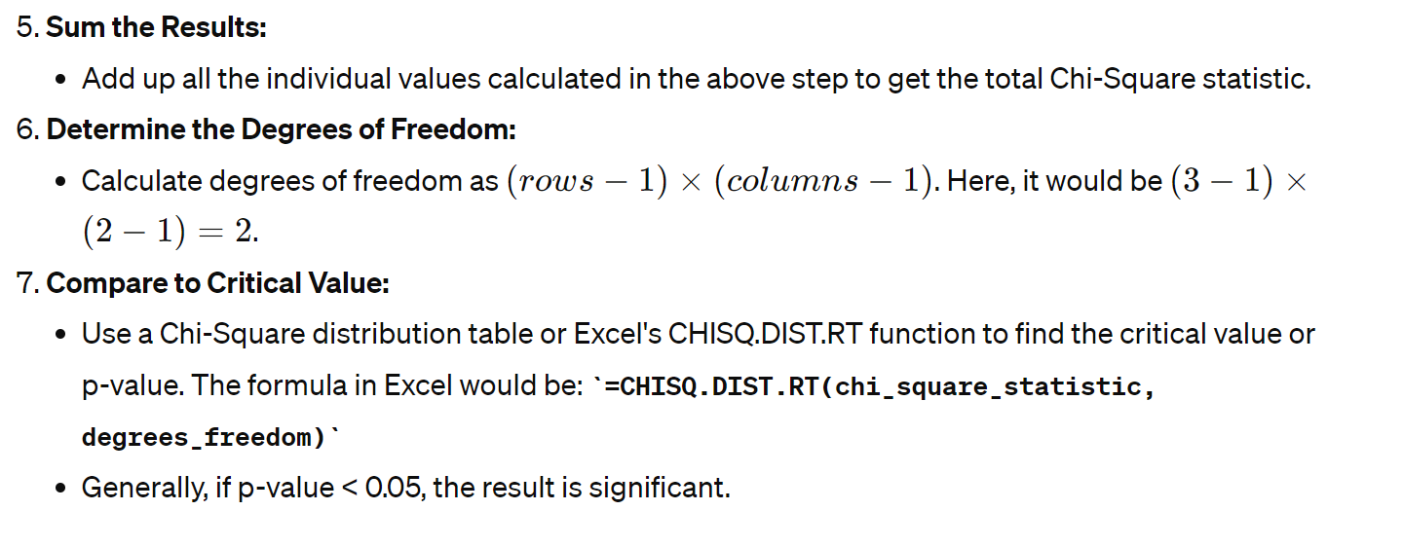
Steps to Solve in Excel

Slide 48
Interpretation
After calculating the Chi-Square statistic and comparing it with the critical value from a Chi-Square distribution table (or using p-value), you can conclude whether there is a statistically significant association between age group and product preference.

Slide 49
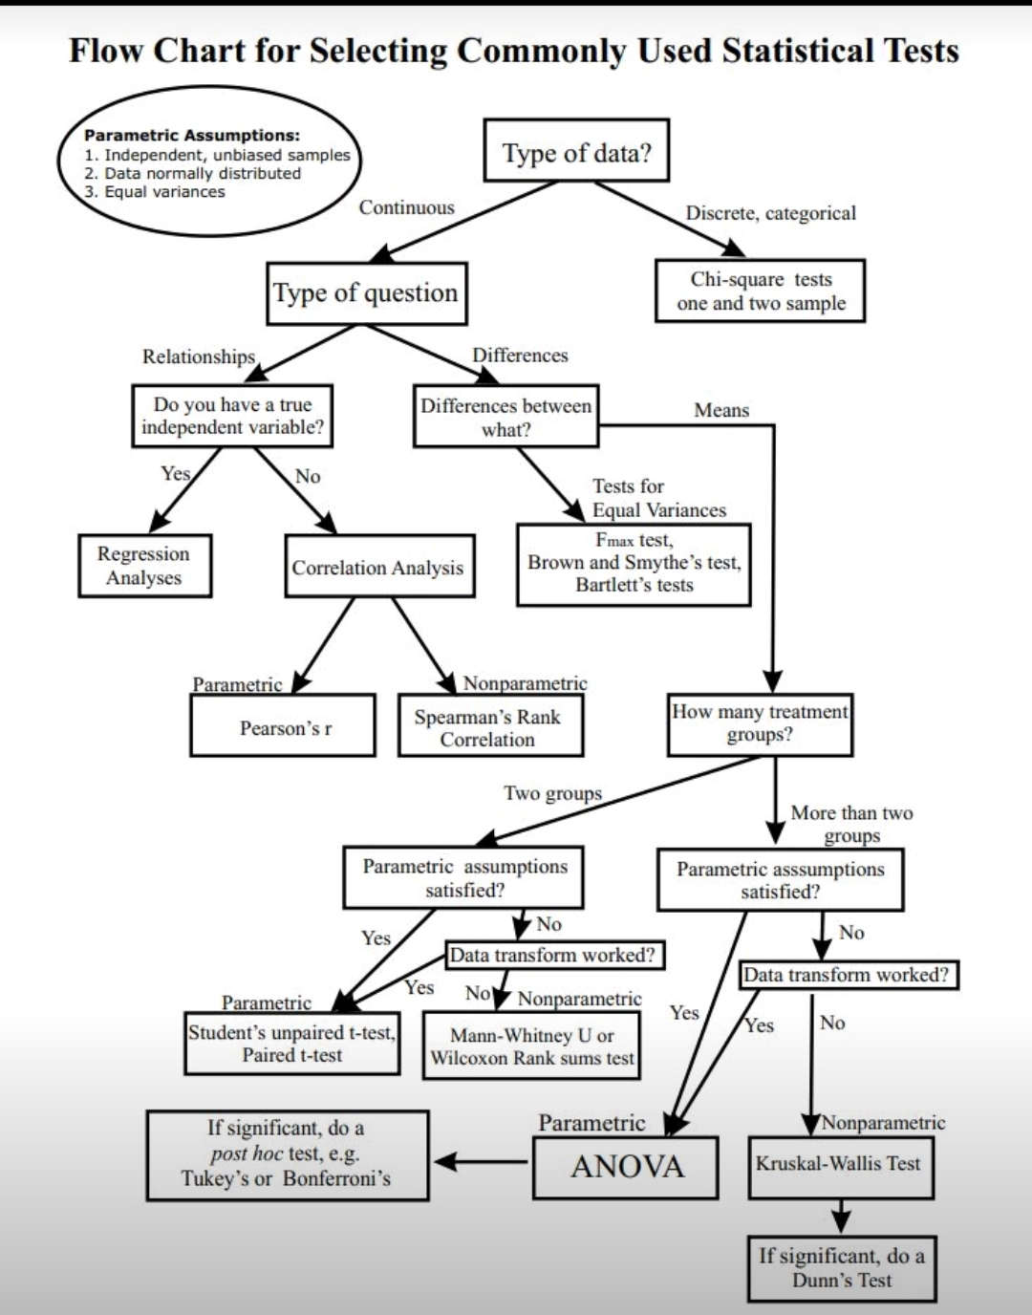
How to Select Test Type

